Slide 1


Social Buzz
Content Analysis
Prepared by: Bekzod Ochilov

Slide 2


Today's agenda
Recap of the Social Buzz client brief
The business problem: Lack of insight into content performance
Team members and roles
Analytics process overview
Final insights: Top 5 content categories by popularity

Slide 3

Social Buzz is preparing for IPO and wants to improve their big data practices.
They asked us to identify the top 5 content categories
by total reaction-based popularity.
These insights will help guide strategy, investor discussions, and product design.
Project Recap

Slide 4

Problem
Social Buzz handles over 100,000 posts per day, generating massive unstructured data. But they lack clarity on which categories perform best.
They need a structured approach to organize and analyze their data to uncover what drives user engagement.

Slide 5




Michelle Grove Data Scientist Builds forecasting models and algorithms to support client growth and scaling.
Marcus Rompton Senior Principal Oversees analytical direction and ensures strategic alignment with client needs.
The Analytics team
Andrew Fleming Chief Technology Architect Leads data strategy and ensures quality, scalable technical solutions.
Bekzod Ochilov Data Analyst Cleans and merges data, performs analytical modeling, and identifies insights that support business recommendations.

Slide 6
Data Cleaning Removed duplicates, standardized text (e.g., lowercased), and trimmed blanks across 3 datasets.
Process
1
Data Merging Used Power BI to join Reactions, Content, and ReactionTypes using Content ID and Reaction Type.
2
Modeling & Measure Creation Built a DAX measure to calculate total popularity score using reaction weights.
3
Analysis Grouped scores by category, visualized them, and extracted the top 5 based on aggregate scores.
4
5
Power BI
Used Power BI for the entire pipeline ensuring efficiency and reproducibility.

Slide 7
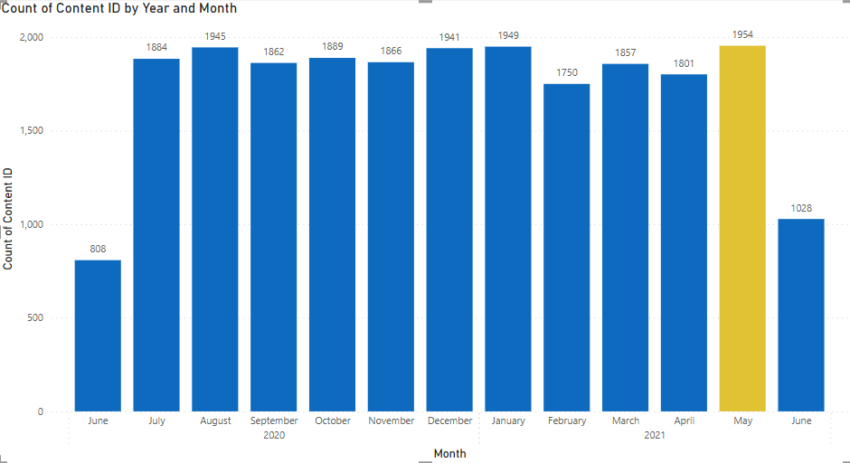
Monthly Content Volume: Year-over-Year Trend
Over a 13-month period, content volume remained relatively consistent, peaking in May 2021 with 1,954 posts. This month-over-month view highlights steady growth and can inform posting strategies around peak engagement times.

Slide 8
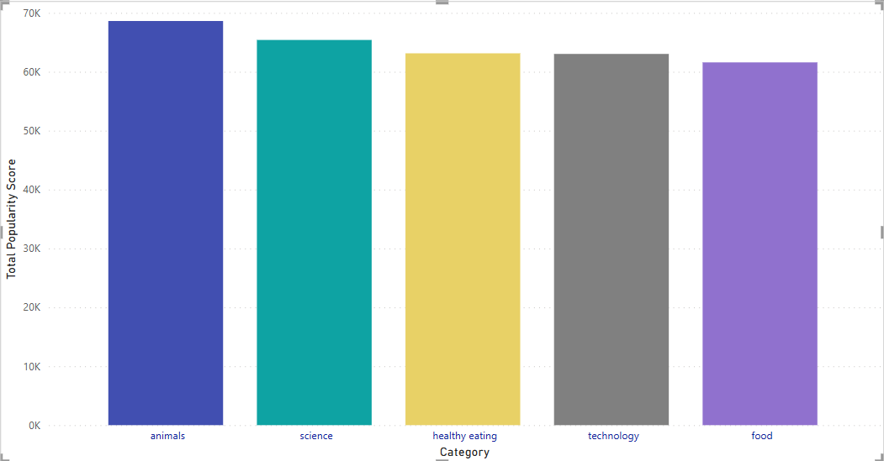

Top 5 Content Categories by Popularity Score

Slide 9
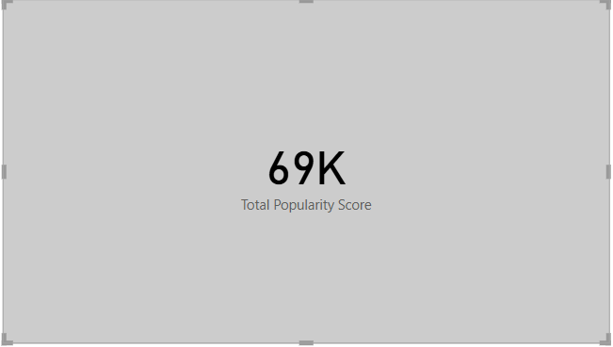
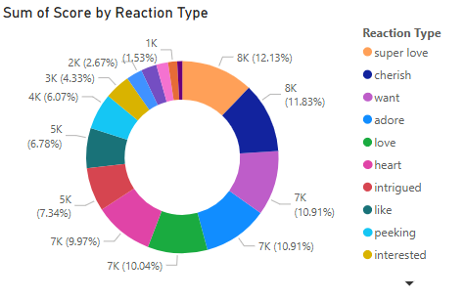
Top Performing Category: Animals
Animals content generated 69K in total popularity score — making it the most engaging category.
Emotional reactions like super love, cherish, and adore led engagement, indicating strong emotional resonance with users.

Slide 10

Summary
The top 5 content categories:
Animals, Comedy, DIY, Fitness, and Nature.
Animals leads with 69K popularity score, driven by strong emotional reactions like “super love” and “cherish”.
May 2021 was the peak posting month, with nearly 2,000 posts.

Slide 11
Thank you!
ANY QUESTIONS?

